Slide 2
CHAPTER 20
Designing an Architecture

Slide 3
A designer knows he has achieved perfection not when there is nothing left to add, but when there is nothing left to take away.
—Antoine de Saint-Exupéry

Slide 4
Chapter Outline
Introduction
Attribute-Driven Design
The Steps of ADD
More on ADD Step 4: Choose Design Concepts(s)
More on ADD Step 5: Producing Structures
More on ADD Step 6: Creating Preliminary Documentation
More on ADD Step 7: Analysis and Review
Summary

Slide 5
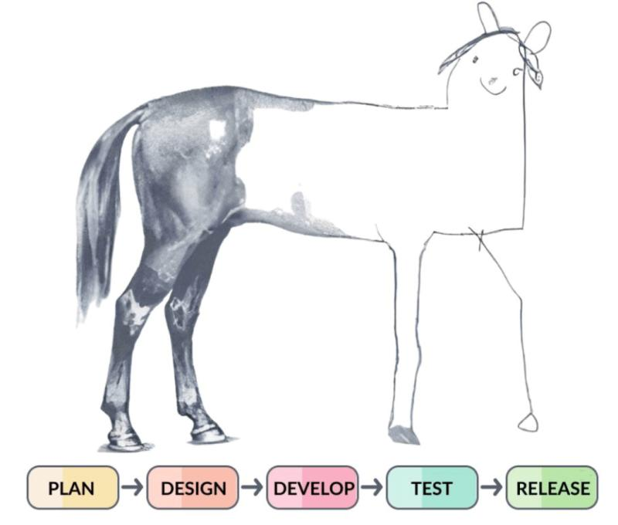
Introduction
Architectural design is a complex activity to perform.
A systematic method provides guidance in performing this complex activity so that it can be learned and capably performed by mere mortals.
In this chapter, we provide a detailed discussion of the method Attribute-Driven Design (ADD) that allows an architecture to be designed in a systematic, repeatable, and cost-effective way.
We begin by providing an overview of ADD and its steps. This overview is followed by more detailed discussions of some of the key steps.

Slide 6
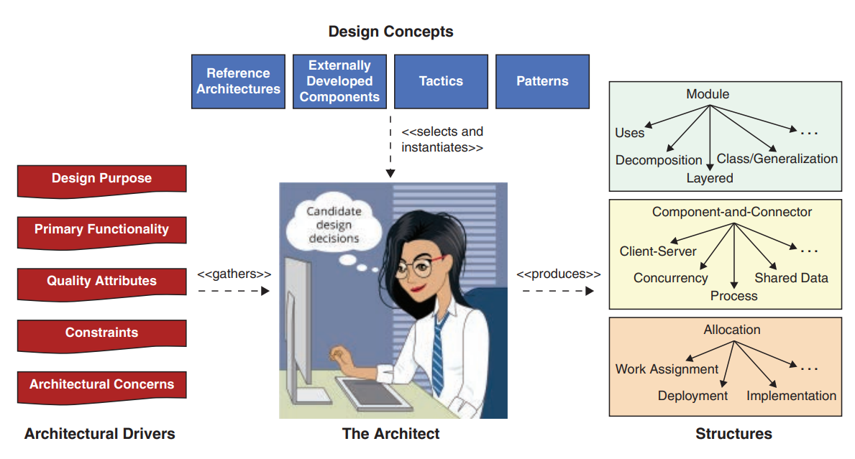
Attribute-Driven Design
In architectural design, we turn decisions about architectural drivers into architectural structures, as shown in the Figure.
The resulting structures are then used to guide the project in the many ways we laid out in Chapter 2.
architectural structures guide analysis and construction.
They serve as the foundation for educating a new project member.
They guide cost and schedule estimations, team formation, risk analysis and mitigation.
and, of course, implementation.

Slide 7
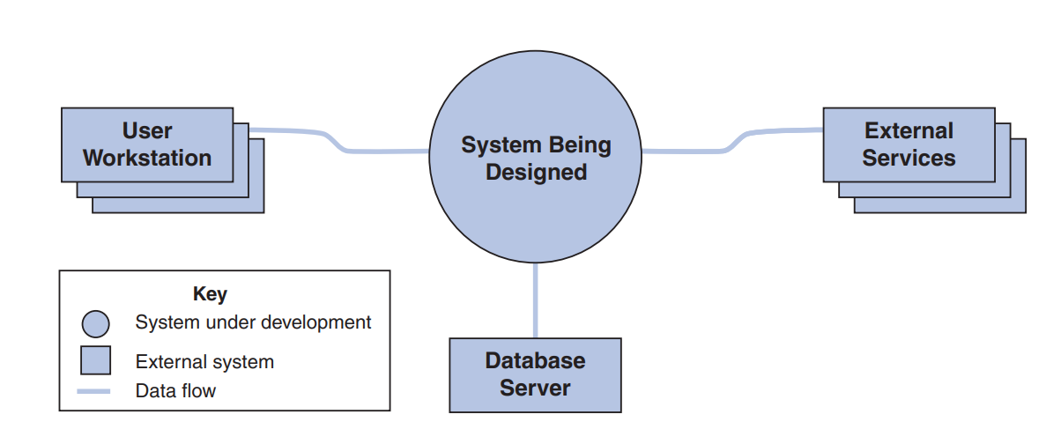
Attribute-Driven Design
First, it’s important to determine what is inside and outside of the system.
And which external entities the system will interact with.
This context can be represented using a system context diagram, like that shown in this Figure.

Slide 8
Attribute-Driven Design
In ADD, architecture design is performed in rounds, each of which may consist of a series of design iterations.
A round comprises the architecture design activities performed within a development cycle.
Through one or more iterations, you produce an architecture that suits the established design purpose for this round.
ADD provides detailed guidance on the steps that need to be performed inside each iteration.
ADD has 7 steps:
Steps 1–7 constitute a round.
Steps 2–7 constitute one or more iterations within a round.

Slide 9
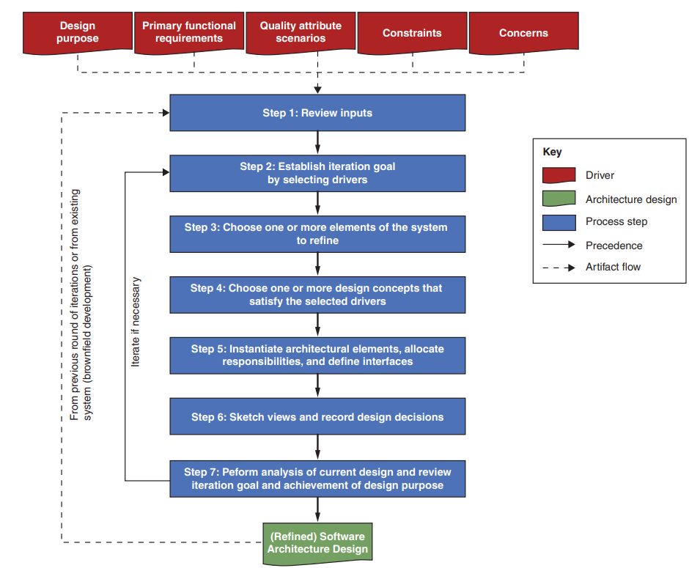
Steps and artifacts of ADD

Slide 10
The Steps of ADD
Step 1: Review Inputs
Architectural drivers are key factors that guide or “drive” the design. drivers are inputs to the design process.
Before starting a design round, you need to ensure that the architectural drivers are available and correct. These include:
The purpose of the design round
The primary functional requirements
The primary quality attribute (QA) scenarios
Constraints and concerns
The purpose for a design round may be
to produce a design for early estimation
to refine an existing design to build a new increment of the system
to design and generate a prototype to mitigate certain technical risks

Slide 11
The Steps of ADD
These drivers form your architectural design backlog, which you’ll work through each iteration.
Step 2: Establish Iteration Goal by Selecting Drivers
Define a clear goal for this iteration by selecting a subset of drivers to address.
Example goal: “Design the structures needed to meet a specific performance scenario.”
A focused goal keeps the iteration on track and tied directly to desired outcomes.
Step 3: Choose One or More Elements of the System to Refine
Select one or more existing elements (modules/components) whose refinement will satisfy the chosen drivers.
Refinement can be decomposition (top-down), combination (bottom-up), or improvement of elements.

Slide 12
The Steps of ADD
For greenfield projects, begin by decomposing the system context; for existing systems, you may need reverse-engineer or discuss with developers.
Step 4: Choose Design Concept(s)
Identify and evaluate alternative design concepts (tactics, patterns, reference architectures, third-party components).
Select the concept(s) most likely to satisfy your iteration goal.
This is often the toughest decision as many options can meet a given driver.
Step 5: Instantiate Elements, Allocate Responsibilities, Define Interfaces
Instantiate the chosen concept (e.g., decide how many layers and their relationships if using the layers pattern).
Allocate responsibilities to each element (e.g., presentation layer handles UI, business layer enforces rules, data layer manages persistence).

Slide 13
The Steps of ADD
Define interfaces (the contracts) that specify how elements will interact and exchange information.
Step 6: Sketch Views and Record Decisions
Capture preliminary diagrams (“sketches”) of the structures you created, take photos of whiteboards if needed.
Record all significant design decisions and their rationale, including trade-offs.
These sketches may be refined in later iterations; formal documentation comes only after all iterations are complete.
Step 7: Analyze and Review
Analyze the current design against the iteration goal. have the selected drivers been addressed?
Conduct a peer review to challenge assumptions and uncover hidden issues.
Review overall purpose: decide if you’ve met this round’s goals or need further iterations.

Slide 14
Iterate If Necessary
You should perform additional iterations and repeat steps 2–7 for every driver that was considered.
However, more often this kind of repetition will not be possible because of time or resource constraints that force you to stop the design activities and move on to implementation.
What are the criteria for evaluating if more design iterations are necessary?
Use risk as your guide: critical drivers should be satisfied or “good enough” before moving on.

Slide 15
More on ADD Step 4: Choose Design Concepts(s)
You don’t reinvent the wheel, your main task is to identify and select existing solutions (patterns, tactics, frameworks).
Creativity lies in choosing, combining, and adapting these concepts to your problem.
Even with a rich corpus (collection of known solutions), selecting the right concepts is often the hardest part of design.

Slide 16
Identification of Design Concepts
There are dozens of options (patterns, third-party components)
You may need to combine multiple concept types (e.g., pattern + tactic + framework) for a single driver e.g., security.
Techniques to Find and Select Candidates
Leverage existing best practices
Use design catalogs to identify many alternatives quickly.
Pros: taps others’ collective knowledge.
Cons: time consuming, unknown quality, unknown assumptions.
Leverage your own experience
Start with patterns you’ve used before for similar systems.
Pros: fast, confident selection.
Cons: risk of over-relying on familiar solutions (“hammer–nail” effect).
Leverage peers’ knowledge
Brainstorm with colleagues to surface diverse ideas and avoid blind spots.

Slide 17
Selection of Design Concepts
After listing alternative design concepts, evaluate each by its pros and cons against your drivers.
Use a comparison table (including cost, strengths, weaknesses) to guide your choice.
Apply decision-making techniques such as SWOT analysis (Strengths, Weaknesses, Opportunities, Threats).
Always respect architectural constraints (e.g., approved-license requirements may rule out some frameworks).
Remember that earlier design choices can limit later options (e.g., an initial web architecture may preclude certain desktop UI frameworks).

Slide 18
Creation of Prototypes
If comparison techniques don’t yield a clear choice, build throwaway prototypes and gather measurements.
These early prototypes focus solely on evaluating a technology or component and are not intended for production or reuse.
Prototyping is especially valuable when:
The project uses emerging or new-to-the-company technologies.
Quality-attribute drivers (e.g., performance, scalability) carry uncertainty or risk.
There’s a lack of trustworthy information about a technology’s suitability.
Configuration options need to be tested to understand their impact.
Integration with existing systems or technologies is unclear.

Slide 19
More on ADD Step 5: Producing Structures
Design concepts alone won’t satisfy architectural drivers unless you instantiate them into concrete structures.
Software architecture is composed of three structure types:
Module structures (e.g., files, modules, classes)
Component & connector structures (e.g., processes, threads)
Allocation structures (e.g., hardware nodes, file systems, teams)
Instantiating a pattern can affect multiple structures (e.g., warm spare redundancy affects C&C and allocation structures).

Slide 20
Instantiating Elements
Here’s how instantiation might look for each of the design concept categories:
Reference architectures: customize by adding or removing elements (e.g., integration component for external payments).
Patterns: adapt generic elements and relationships to your problem (e.g., choose number of clients/servers, protocols in client-server).
Tactics: realize tactics via existing concepts or custom code (e.g., integrate authentication into the login process or adopt a security framework).
Externally developed components: may require subclassing or configuration (e.g., inherit framework classes or set thread-pool size).

Slide 21
Associating Responsibilities and Identifying Properties
Allocate clear, cohesive responsibilities to each element to maintain high cohesion and low coupling.
Decide microservice responsibilities, deployment counts, and key properties (e.g., statefulness, resource limits).
Identify element properties such as configuration options, priority, or hardware characteristics.

Slide 22
Establishing Relationships Between Elements
Define how elements interact: which clients talk to which servers, ports, protocols, and sync vs. async communication.
Decide interaction initiators, data volume, and transfer rates.
Recognize that these relationship decisions directly impact quality attributes like performance.

Slide 23
Defining Interfaces
External interfaces: contractual boundaries with other systems; usually fixed by external specifications.
Internal interfaces: define element collaborations (e.g., commands from UI tier to business logic).
Use UML sequence diagrams or statecharts to model and refine information exchanges.
Refine interfaces incrementally: start abstract, then specify details as design iterations progress.
If using interoperable technologies, many interface details are pre-defined.

Slide 24
More on ADD Step 6: Creating Preliminary Documentation
Software architecture is documented as a set of views, which represent the different structures that compose the architecture.
Although formal view documentation is not part of ADD, capturing your design structures, even as informal sketches, should be part of normal ADD activities.
Sketches, along with the design decisions that led to them, serve as initial architecture documentation you can refine later.

Slide 25
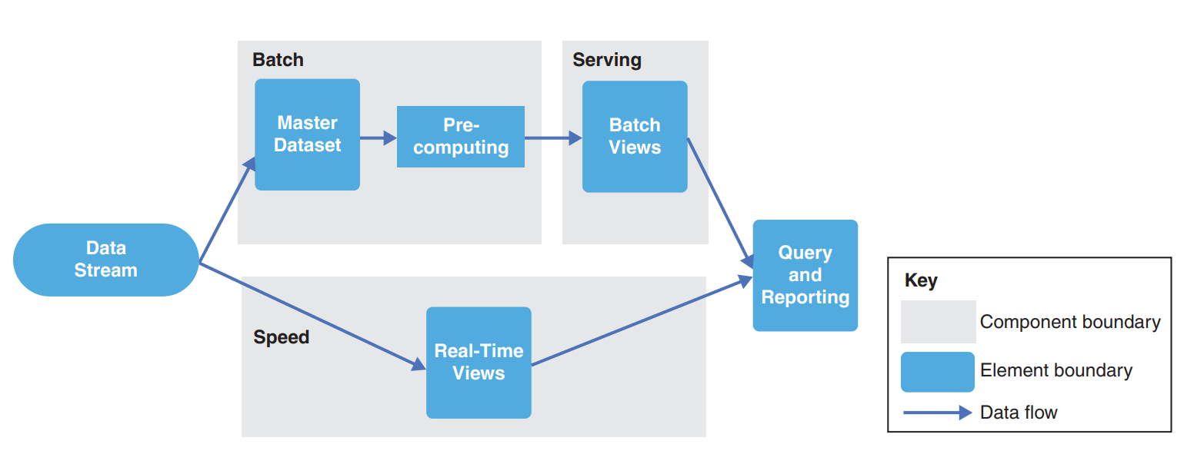
Recording Sketches of the Views
As you instantiate selected design concepts, create sketches on a whiteboard, paper, etc.
You don’t need a formal language like UML
just maintain consistency in your symbols and add a legend later to avoid ambiguity.
Write down each element’s responsibilities as you sketch.
A simple way to preserve whiteboard work is to photograph your sketch and paste it into a document alongside a table summarizing each element’s responsibilities
An example preliminary documentation is shown in this figure.

Slide 26
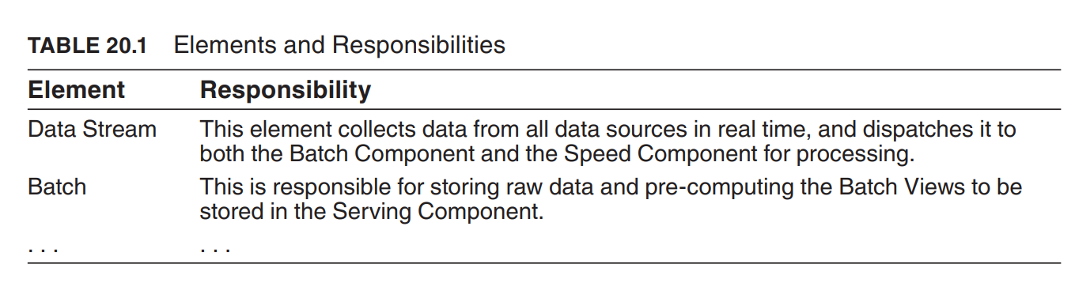
Recording Sketches of the Views
The diagram is complemented by a table that describes the element’s responsibilities.
This table serves this purpose for some of the elements identified in previous figure.
Document only what’s needed for your chosen purpose; analysis, construction, or education based on the risks you must mitigate.
For example, to train new team members, sketch a C&C view showing runtime interactions and a module view showing major layers or subsystems.

Slide 27
Recording Design Decisions
In each iteration you make key design decisions to meet your goals; capturing them preserves your design rationale (reasoning or justification behind a design decision).
A diagram shows the end result but not the reasoning behind it. recording decisions clarifies how you arrived there.
These recorded decisions become invaluable when your design is later analyzed or revisited.
Recording decision rationale helps future team members understand why certain options were chosen over others.

Slide 28
More on ADD Step 7: Analysis and Review
At the end of an iteration, perform analysis to reflect on the design decisions you just made.
Assess whether you have done enough design work by asking:
How much design do you need to do?
How much design have you done so far?
Are you finished?
Use practices like backlogs and Kanban boards to track design progress and answer these questions.

Slide 29
Use of an Architectural Backlog
An architectural backlog is a to-do list of pending actions in the architecture design process.
Initially populate the backlog with your drivers; then add other activities such as:
Creating a prototype to test a technology or address a QA risk
Exploring existing assets (possibly via reverse engineering)
Issues uncovered during a review of earlier design decisions
As decisions are made, add new concerns. for example, if session management is missing in a chosen reference architecture, add that to the backlog.

Slide 30
Use of a Design Kanban Board
A Design Kanban Board typically has three columns:
Not Yet Addressed
Partially Addressed
Completely Addressed
Workflow:
At iteration start, place all drivers in Not Yet Addressed.
Move a driver to Partially Addressed when you begin addressing it.
After analysis confirms a driver’s requirements are met, move it to Completely Addressed.
Establish clear criteria for each transition.
A Kanban board provides a visual snapshot of how many, and which, drivers remain to be fully addressed, helping you decide if more iterations are needed.

Slide 31
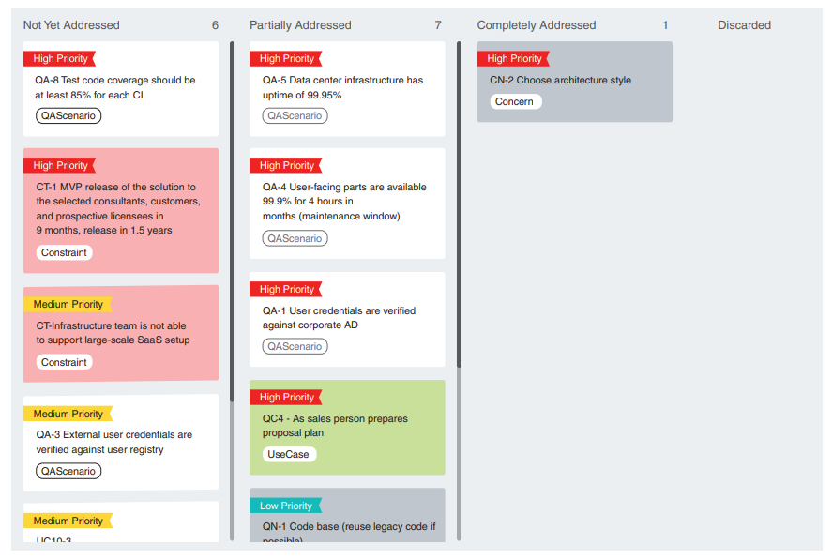
An example of a kanban board used to track design progress

Slide 32
Summary
Design is hard. Methods are needed to make it more tractable and repeatable.
In this chapter, we discussed the attribute-driven design (ADD) method in detail; it allows an architecture to be designed in a systematic and cost-effective way.
We also discussed several important aspects that need to be considered in the steps of the design process.
These aspects include the identification and selection of design concepts, their use in producing structures, the definition of interfaces, the production of preliminary documentation, and ways to track design progress.

